Slide 1
Robot Raconteur Training Seminar
Day 2
John Wason, Ph.D.
Wason Technology, LLC
16 Sterling Lake Rd, Tuxedo, NY, 10987
wason@wasontech.com

Slide 2
RR Nodes Vs. Services
An RR node is an instance of RR that acts as a server
A node can contain multiple services that it will manage the input and output for
Only one TCP port is used for the node but the services are addressed using their unique names
For example one Kinect Camera can be controlled by one RR Node but all of it’s different sensors are individual services, one Kinect Camera node has services for Point Cloud capture, Multicamera Video capture and Body Tracking Capture

Slide 3
RR Naming
Naming within Robot Raconteur Services follows specific rules to help interoperability
These rules apply to Service Definitions, Objects, Structures and Members
All names must consist of only letters, numbers and underscores
Names must start with a letter
No name should start with any combination of the following: “RobotRaconteur”, “RR”, “get ”, or “set ”
Lastly service names should not end with “_signed”

Slide 4
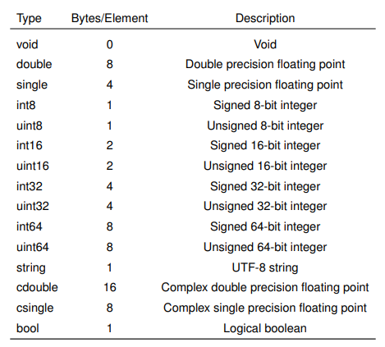
RR Basic Data Types

Slide 5
RR Structures
Structures are collections of value types
Structures are defined in Robdefs and can contain primitives other structs or any other RR data type
Each structure is given a unique name in the robdef and declared with the keyword “struct”
Each entry in the struct is declared with the keyword “field” followed by the data type and then the entry name
The structure definition in the robdef is closed by the keyword “end”
Structures are important methods for packaging and sending data in a coherent fashion

Slide 6

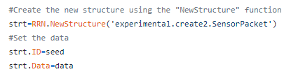
Examples of RR Structures
Robdef Structure Definition
RR Structure Instantiation

Slide 7
RR Lists and Maps
Lists and maps both contain multiple values in an array
Maps specify keys for each value that can be of any type (similar to regular Python maps)
List values are addressed by Ints like a regular Python list
Only Structs, Maps and Lists can be made Null
If an RR List is a property of a service the entire list must be set or got, an individual element cannot be changed

Slide 8


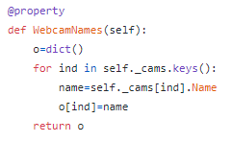
Declaration of RR Lists and Maps
Robdef List Definition
RR List Instantiation
Robdef Map Definition
RR Map Instantiation

Slide 9
RR Enums
Enums are a special representation of Int32 with named values
Values that can be used are signed integers, unsigned hexadecimal or left empty to implicitly increment from the last value
Format for enums is “name” = “value”
The enum values can then be referred to either by their name or value
Useful for more explicitly defining acceptable values for functions

Slide 10
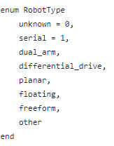
Declaration of RR Enums
Robdef Enum Declaration

Slide 11
RR Named Arrays
Structures designed to store numeric arrays in named formats, a good example is Vector3
Named Arrays have the most compact memory storage
Named Arrays can only contain primitives, other named arrays and fixed size arrays of both
You must import other robdefs before starting your service if you are using Named Arrays from them
In Python these are created as Numpy lists and given types from the RR robdefs

Slide 12
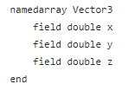
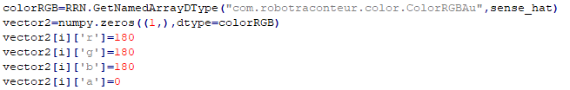
Declaration of RR Named Arrays
Robdef RR Named Arrays Definition
RR Named Arrays Instantiation

Slide 13
RR Data Mapping
Robot Raconteur uses more strict type mapping than python normally requires
For all numeric arrays RR uses numpy arrays
Maps in RR are Dicts in Python
Lists in RR are Lists in Python
Enums in RR are stored as ints

Slide 14
RR Callbacks
Callbacks are reverse functions
Callbacks are declared in the service but expected to be fulfilled by any client that connects to them
Callbacks provide a reliable way for a service to request information or perform tasks on a client
The callback function must be defined by the connecting service

Slide 15

Declaration of RR Callback
Robdef Callback Definition
RR Callback Client Definition

Slide 16
Robdef Importing
Robdef files can import other Robdef files to use the defined members and structures in them
To do this use import at the top of your Robdef file
Very useful for utilizing standardized Robdefs
To more easily reference needed members or structures Using can be used, such as:
import com.robotraconteur.image
using com.robotraconteur.image.Image
function Image capture_frame()

Slide 17
Command Line Options
It is good to design services to be adaptable and able to be started using different ports, different service names and take in different parameters
In Python this can be done using the parser library as follows:
parser = argparse.ArgumentParser(description="Example Robot Raconteur iRobot Create service") parser.add_argument("--nodename",type=str,default="sense_hat.SenseHat",help="The NodeName to use")
parser.add_argument("--tcp-port",type=int,default=2354,help="The listen TCP port")
parser.add_argument("--wait-signal",action='store_const',const=True,default=False)
args = parser.parse_args()

Slide 18
RR Service Design
RR Services should be designed in a relatively uniform manner
A professional RR Service should encapsulate as much of the functionality of the underlying device as possible
Data should also be collected and published using Threading as much as possible
As much as possible standardized Robdefs should be used to maintain interoperability between services of similar devices

Slide 19
RR Service Threading
As much as possible Python Threading should be used to send data from sensors or process certain inputs in parallel
For documentation on Python threading you can visit here: https://docs.python.org/3/library/threading.html
For many systems it is ideal to have a function to start the streaming and capturing of data, this should instantiate and start the thread used to publish the data
Usually a while loop or conditional checking a streaming variable works well to allow a method of stopping data collection using a stop streaming function call

Slide 20
RR Exclusive Object Locks
Because Robot Raconteur services are multi-threaded by design a client can call multiple functions at the same time
If a client calls two functions concurrently that access the same variable the data in that variable can be corrupted
To prevent this, Python threading locks should be used whenever a thread might access a variable that is altered somewhere else outside of that thread
These locks when acquired by a thread prevent any other threads currently running from executing until the lock has been released

Slide 21
RR Async Functions
Robot Raconteur clients can also perform RR functions such as connecting to services asynchronously
This is ideal for situations where a client needs to connect to many services and perform many functions at once without waiting for them to return their values
The async function calls are basically the same except async_ precedes the function name and a function handler and a timeout value can be specified
For example an async service connect looks like:
c=RRN.ConnectService(url,function_handler,timeout)

Slide 22
RR Member Modifiers
Different RR members can be modified within the Robdef to give them certain properties
Properties can have the modifiers: readonly, writeonly, urgent, perclient
Functions and events can only have the urgent modifier
There is also the unreliable attribute that labels a data sender as being potentially lossy
The urgent modifier labels a property or data pipe as higher priority and can be used for safety signals and stops
The perclient modifier specifies that the value of the property is unique to each client

